Slide 1

Jenson USA Data-Driven Insights for Business Optimization

Slide 2
Overview of Jenson USA
A retail company dealing with various products across multiple stores
Key focus areas: customer behavior, staff performance, inventory management, and store operations
Project Objective: Utilize SQL to derive insights from the given dataset

Slide 3
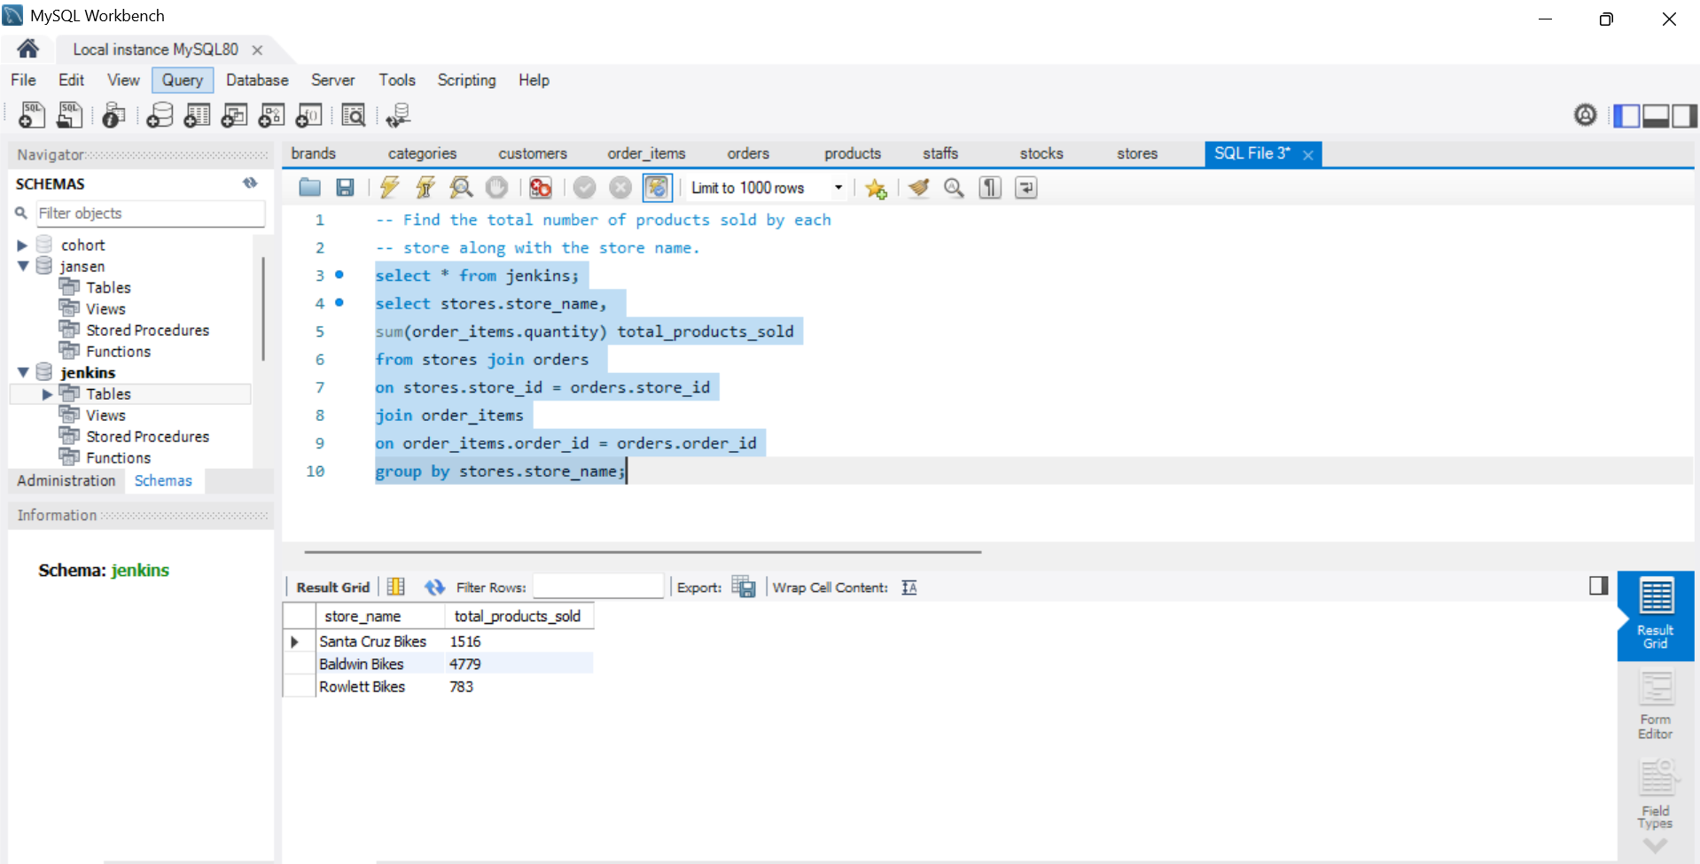
Query 1: Total Number of Products Sold by Store
Insight: Identifies top-performing stores based on sales volume

Slide 4
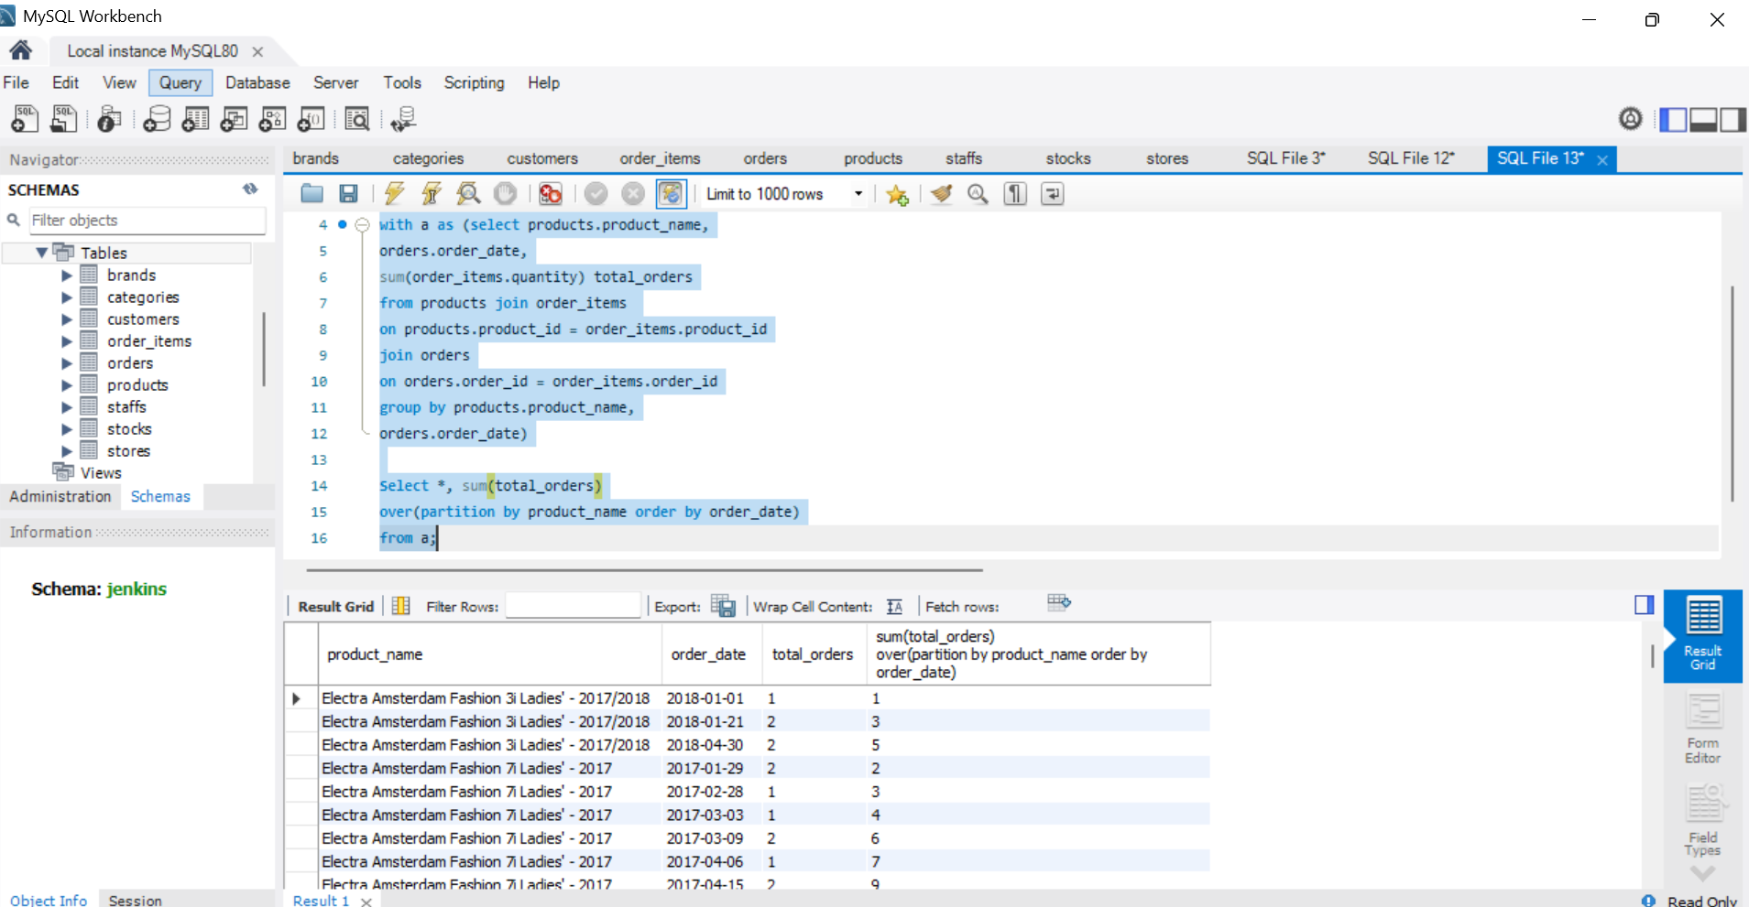
Query 2: Cumulative Quantity Sold per Product Over Time
Insight: Helps in inventory demand forecasting

Slide 5
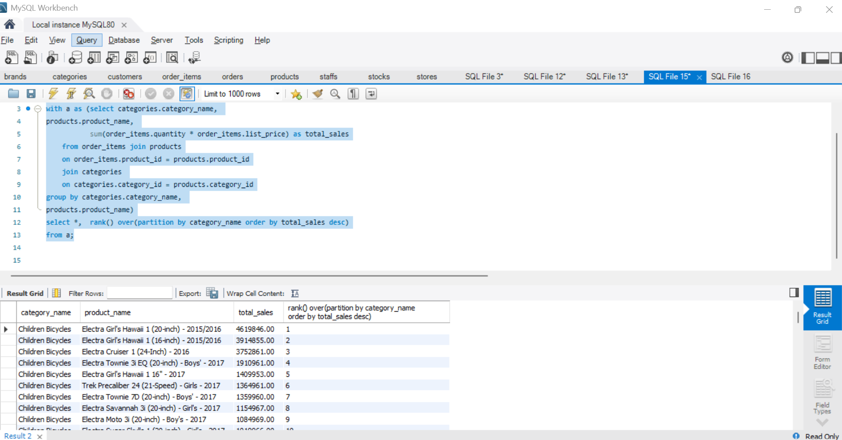
Query 3: Product with Highest Sales per Category
Insight: Determines best-selling products in each category

Slide 6
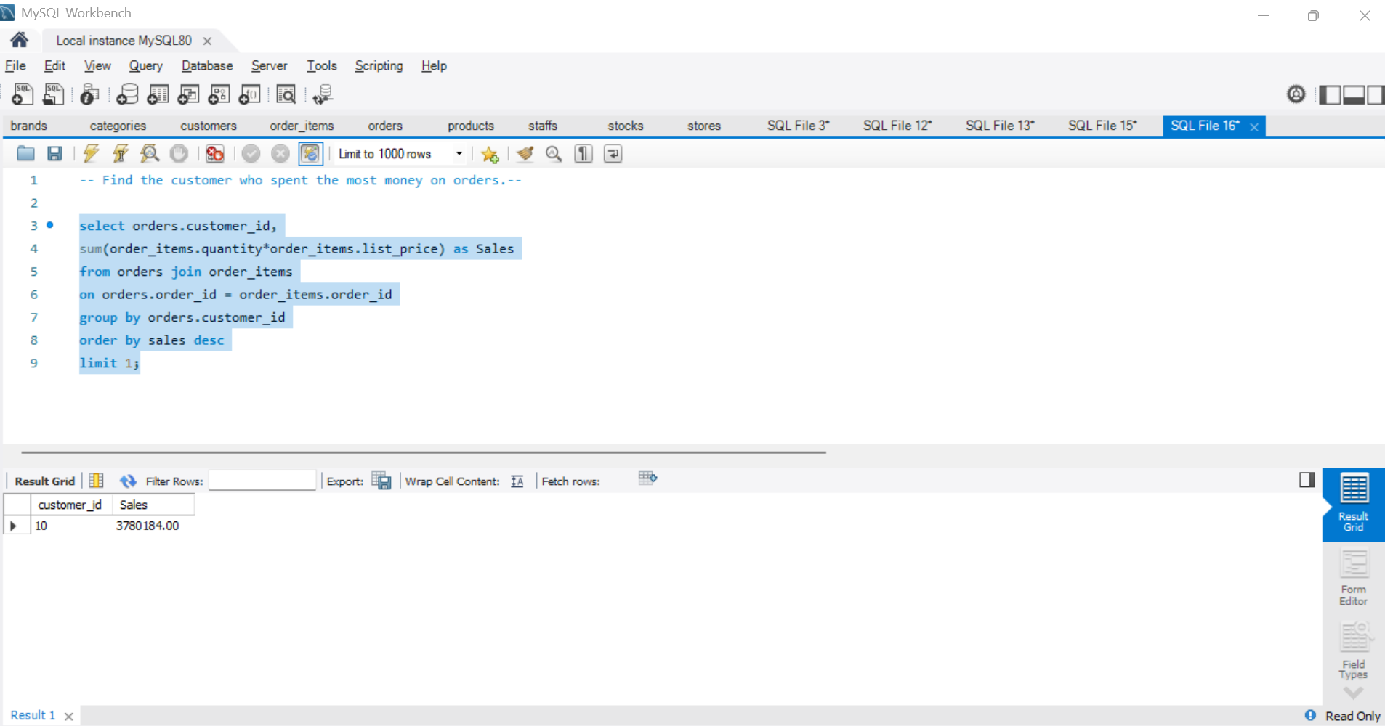
Query 4: Customer with Maximum Spending
Insight: Identifies the most valuable customer.

Slide 7
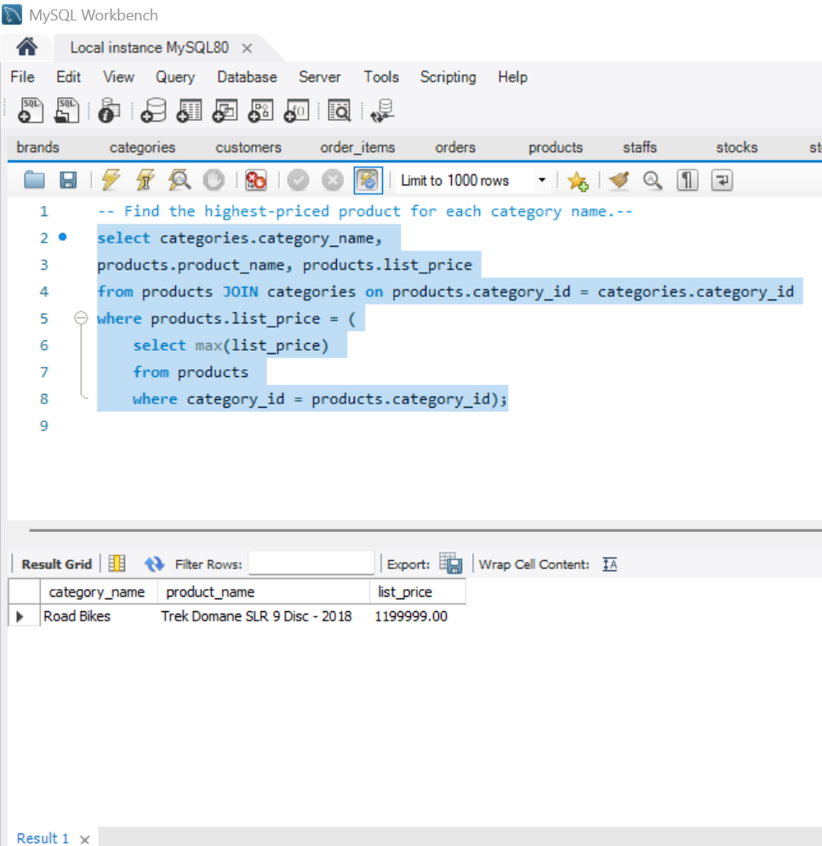
Query 5: Highest Priced Product in Each Category
Insight: Useful for pricing strategies.

Slide 8
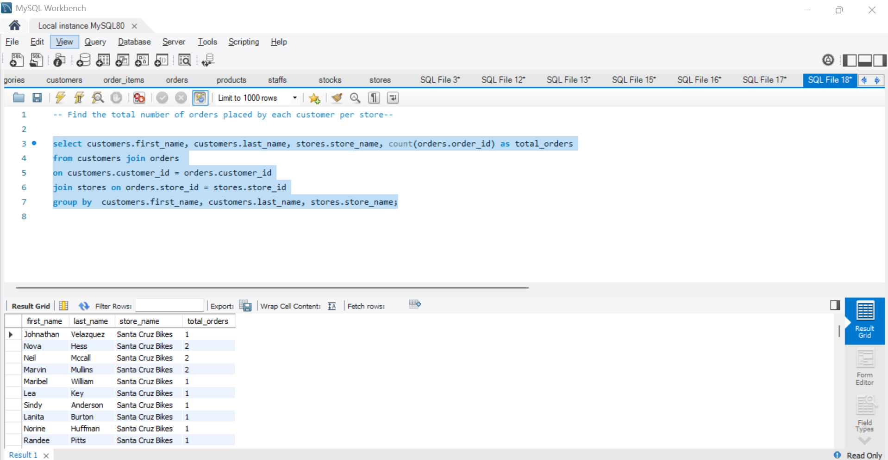
Query 6: Orders per Customer per Store
Insight: Understands customer shopping patterns.

Slide 9
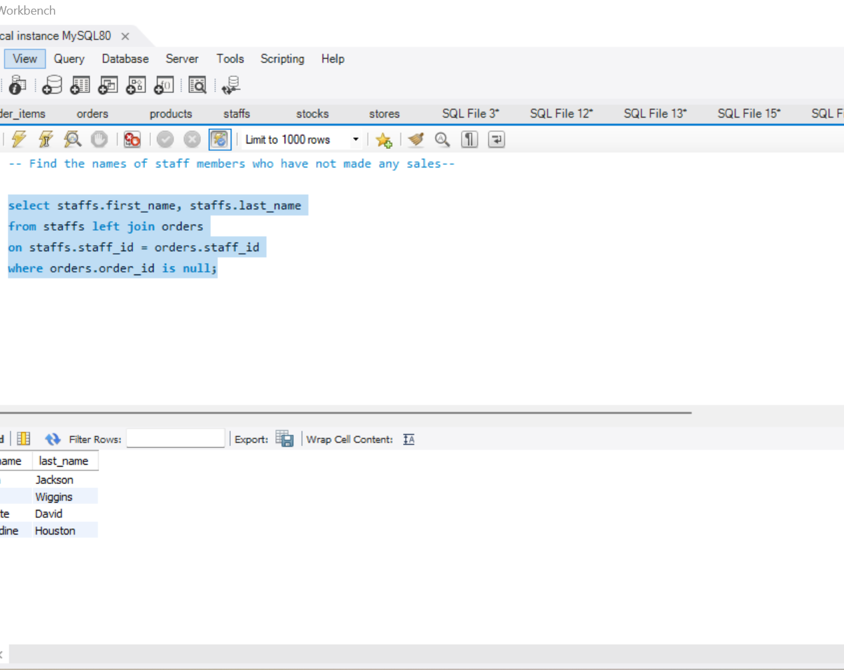
Query 7: Staff with No Sales
Insight: Helps in staff performance evaluations.

Slide 10
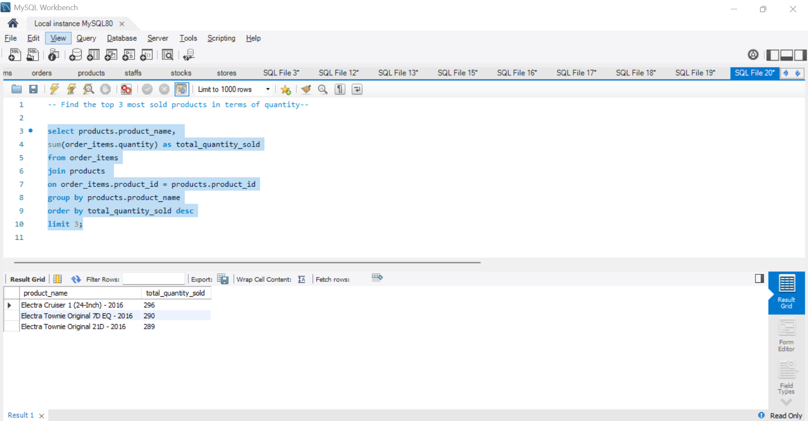
Query 8: Top 3 Most Sold Products by Quantity
Insight: Determines the most in-demand products.

Slide 11
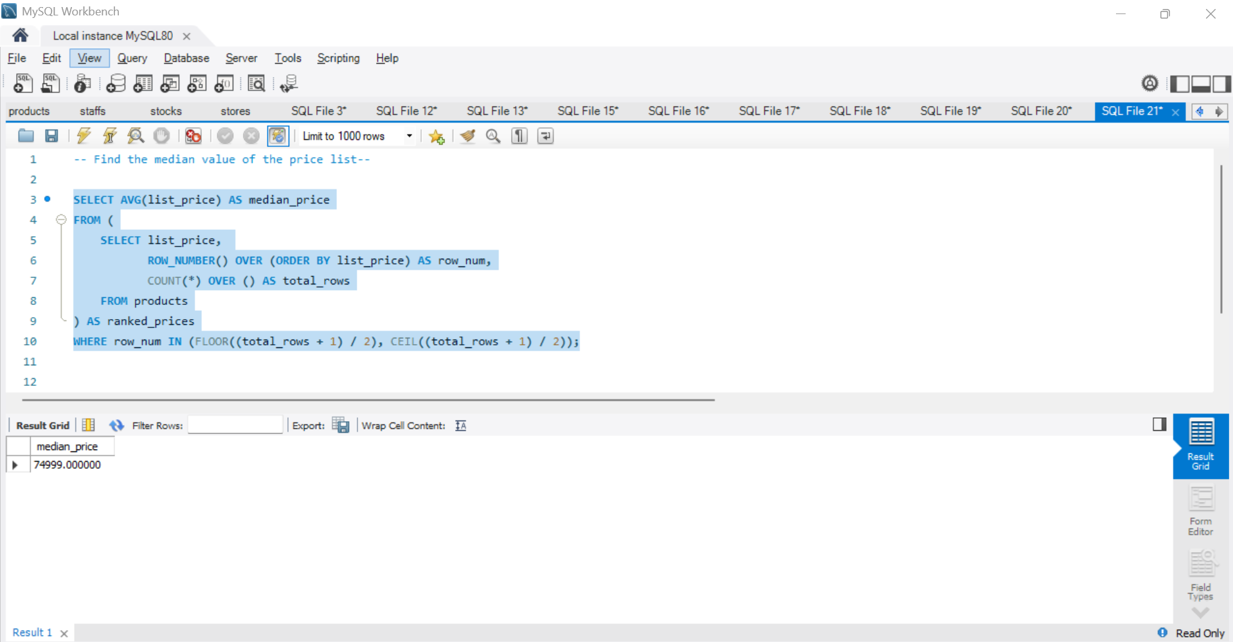
Query 9: Median Price of Products
Insight: Helps in pricing strategy decisions.

Slide 12
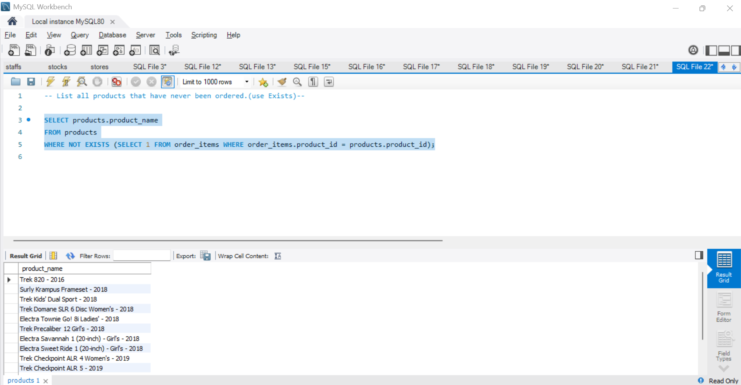
Query 10: Products Never Ordered
Insight: Helps in stock optimization.

Slide 13
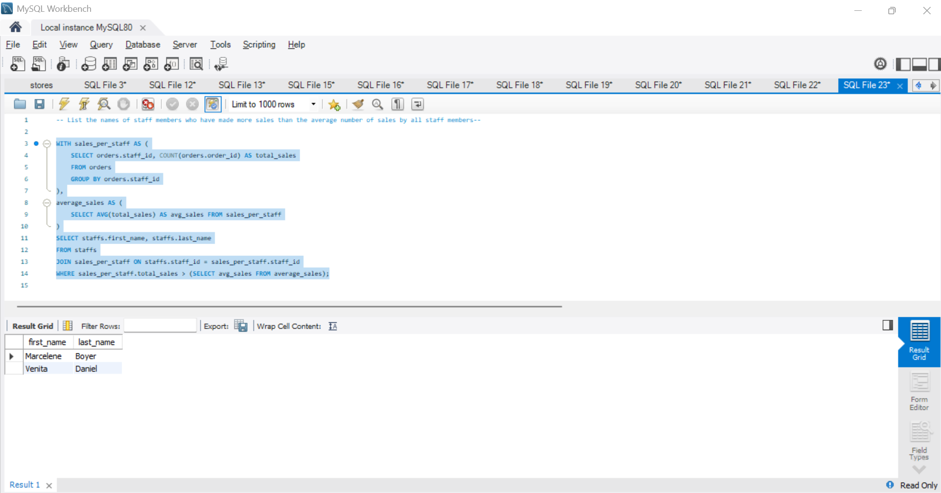
Query 11: Staff Members with Above-Average Sales
Insight: Identifies high-performing employees.

Slide 14
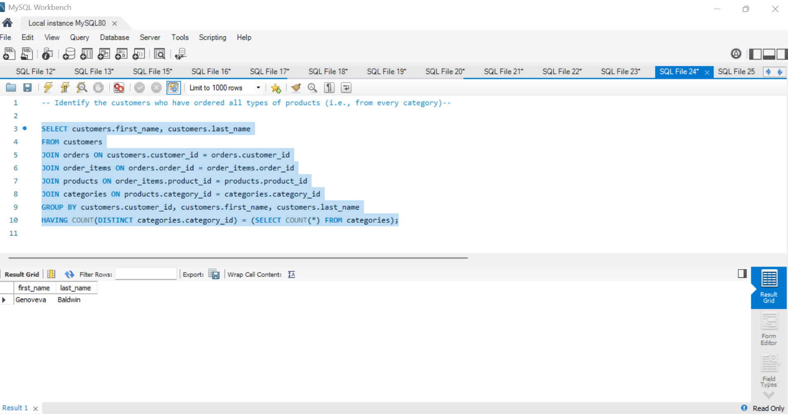
Query 12: Customers Ordering from All Categories
Insight: Identifies highly engaged customers.

Slide 15
Conclusion & Recommendations
Key Findings:
Best-performing stores and products identified.
Top customers and high-revenue items determined.
Underperforming staff and low-demand products analyzed.
Business Recommendations:
Improve inventory and demand forecasting.
Implement targeted marketing strategies for high-value customers.
Optimize staff performance through sales-based incentives.
Reevaluate pricing and stocking strategies for slow-moving products.

Slide 16

Thank You!

